Slide 1
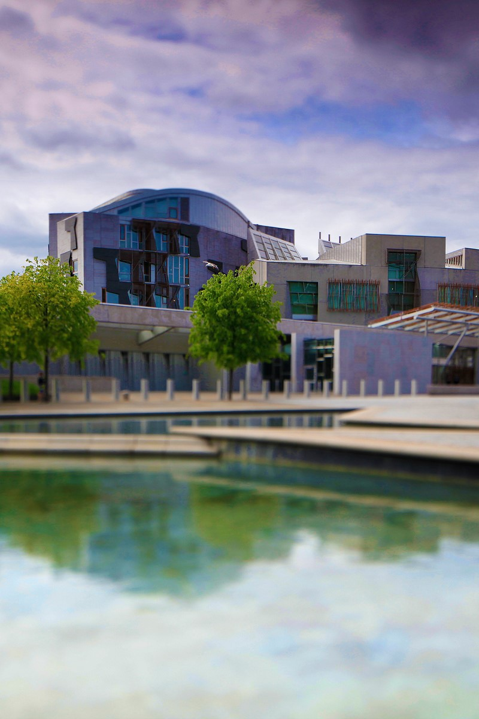
Public Engagement Services Office Education Officer (maternity cover) Application Pack

Slide 2
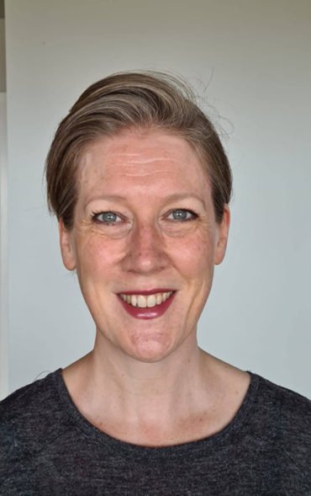
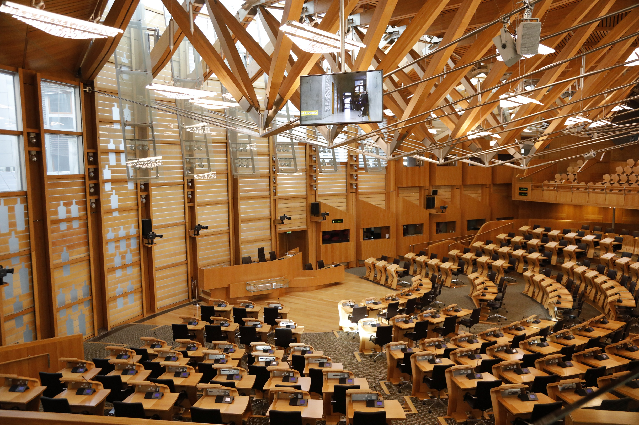
Welcome from Sally Coyne Head of Public Engagement Services
Hello and thank you for taking an interest in our Education Officer role. As Head of Public Engagement Services Office, I am very proud of the work our staff do to support the public in accessing and engaging with their Parliament.
In the Public Engagement Services Office (PESO), our Education Services team work alongside colleagues delivering services to visitors to Holyrood, to the public with their enquiries and to people who use BSL, Gaelic and other formats to access the Parliament. All our work is to the same purpose - making a positive difference to the lives of the people of Scotland. All team members are valued for the contributions they make and from the day you join, I know your colleagues will welcome you and support your journey of learning the role.
The role is a great opportunity to work in an iconic building in Scotland and be at the heart of informing and inspiring pupils and students from across Scotland to learn more about our democracy and the work of our Parliament. In our team, we pride ourselves on our willingness to learn and work with others to create services and opportunities that people want and enjoy.
If you share our ambition to deliver a welcoming and inclusive education service that encourages public involvement in our work, we’d really like to hear from you.

Slide 3
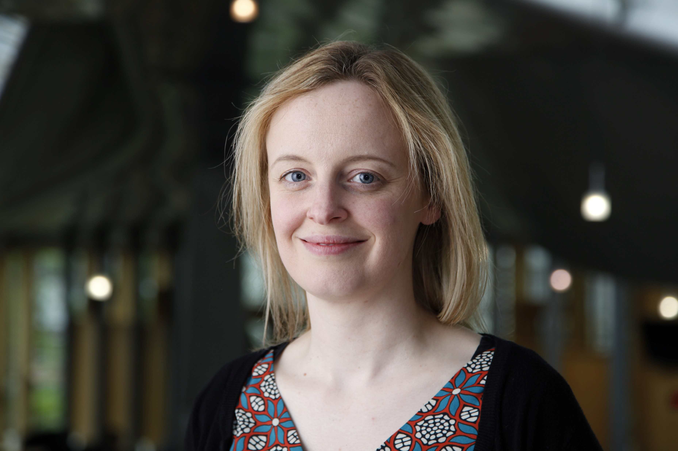
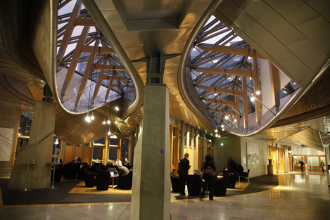
Working as an Education Officer
As a team we provide an education service for schools, colleges, and other education routes across Scotland, which supports learning about and engaging with our Scottish Parliament.
I have worked for the Education Service at the Parliament for nine years. In that time, I have delivered a wide variety of engagement sessions for groups studying at Curriculum for Excellence Second, Third and Fourth Levels; introducing pupils to their Parliament, its workings and how they can have their voice heard.
I also regularly provide sessions for students across the Senior Phase of high school and those in further education working towards qualifications in areas such as Modern Studies and Politics. The role involves developing and updating educational resources to support a range of different abilities. As an Education Officer you also assist Members of the Scottish Parliament as they engage with their young constituents.
It is an interesting, varied and rewarding role that gives you the chance to empower young people.
Frances Mowat Education Officer

Slide 4
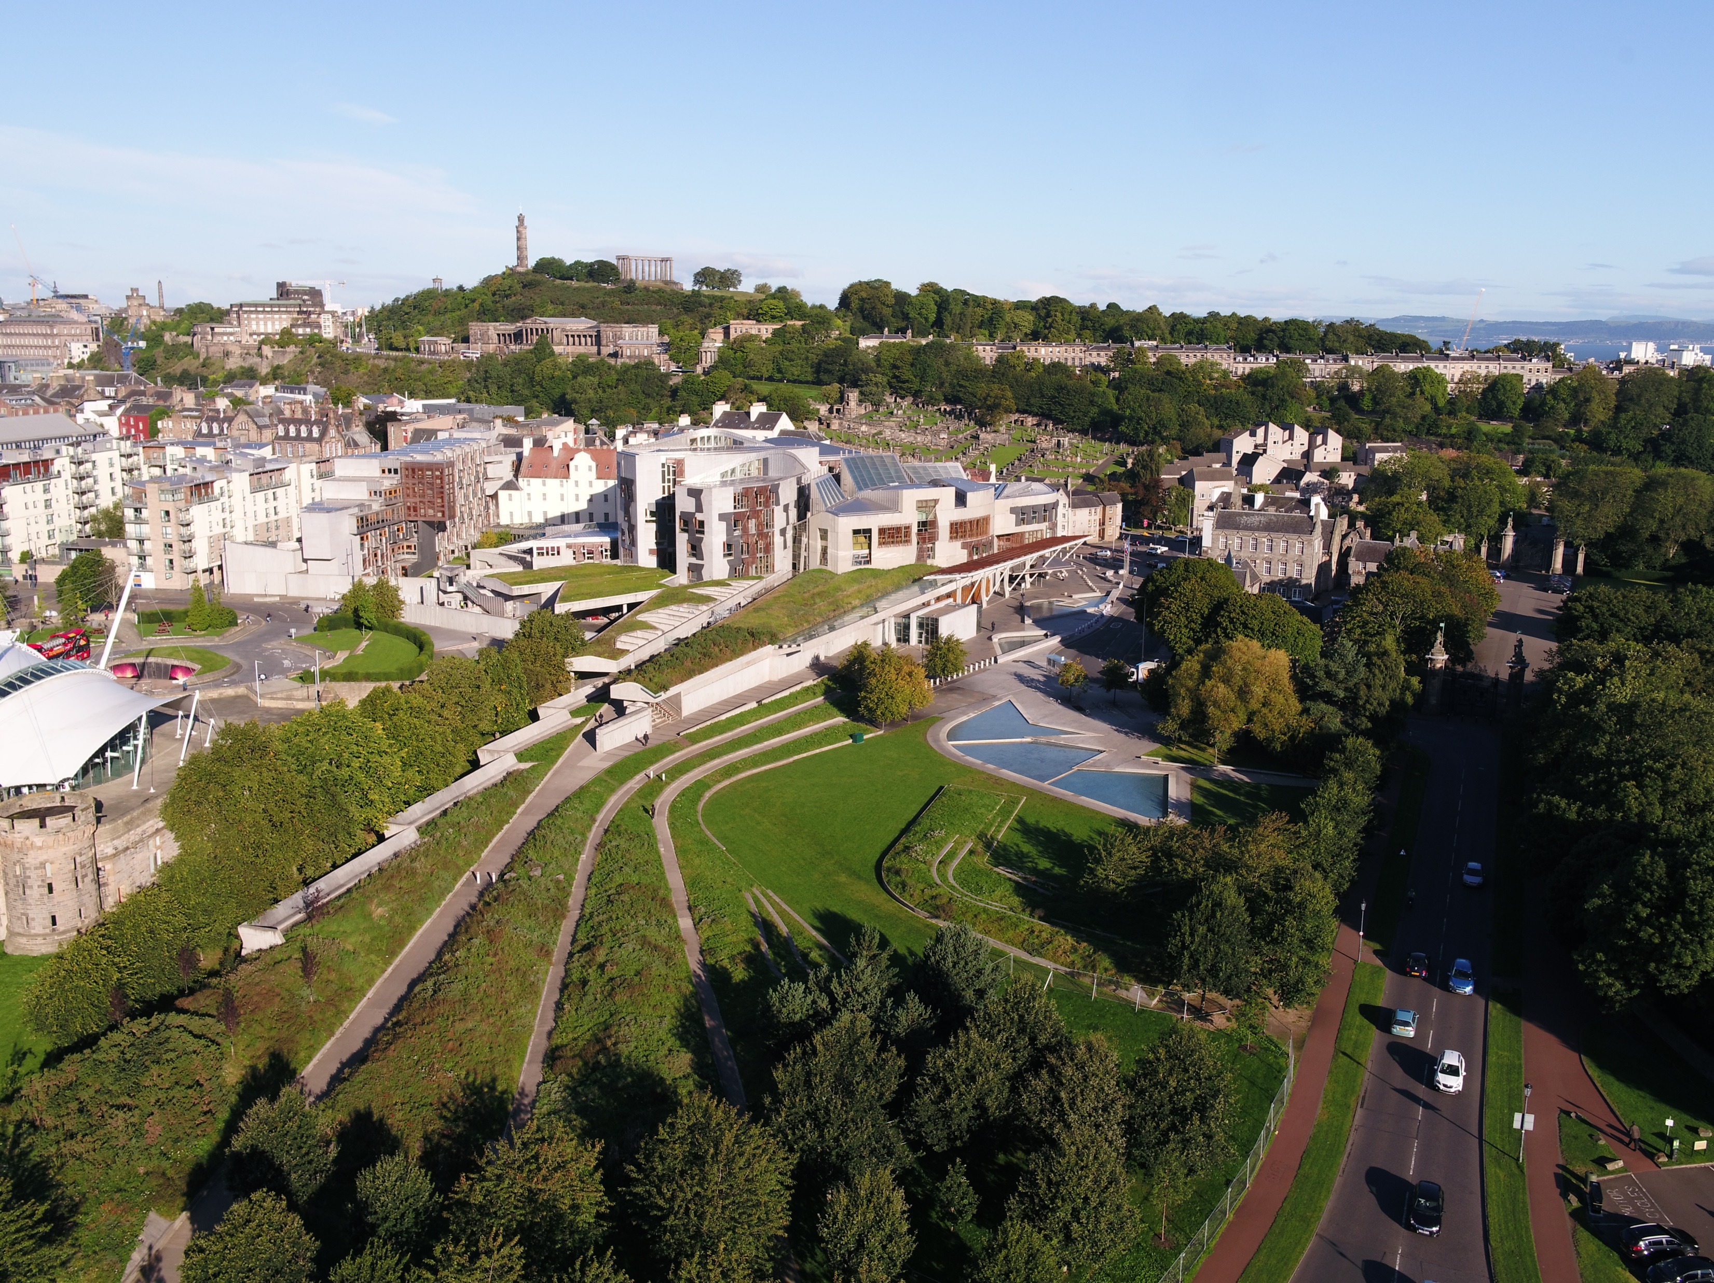
Education Officer – Public Engagement Services Office (PESO), Grade3 Fixed Term until June 2025 (maternity leave cover)
Want to make a difference in one of the most influential places in Scotland? Now is your chance!
Salary range: £27,567.20 – £33,344 (FTE £34,459 - £41,680)
Working pattern: This is a part-time post (29 hours 36 minutes, 7 hours 24 over 4 days (Monday- Wednesday, and either Thursday or Friday) however we are happy to talk about flexible working. We’re committed to supporting staff to achieve a healthy work-life balance. This is a hybrid role, mostly working from Holyrood, with the flexibility of working from home on occasion. It’s a term-time post and you’ll be expected to take annual leave during our February and April recess periods.
This is an excellent opportunity to join the Education Services team, part of the Public Engagement Services Office, as an Education Officer.
The Education Service helps children and young people of Scotland find out more about their Scottish Parliament. We do this by supporting education establishments (in Holyrood, across Scotland and online) with sessions and resources aligned to the curriculum. The Education Service is part of Public Engagement Services. We provide continuous professional learning opportunities to teachers and a variety of teaching resources.
The Education Services team is made up of around ten staff, eight of whom are Education Officers. As an Education Officer you’ll deliver curriculum aligned education sessions to visiting Scottish school groups in Holyrood. This includes presenting to the group, developing and delivering activities, and providing a tour of the Parliamentary building. You’ll occasionally deliver online sessions to schools. You’ll be involved in educational event days and work on projects to develop learning resources for online and print.

Slide 5
Education Officer – Public Engagement Services Office (PESO), Grade3 Fixed Term until June 2025 (maternity leave cover)
The successful candidate will have a teaching, education or youth work qualification, and at least 1-year experience working with children and young people. You’ll have experience in leading effective learning, creating a positive learning environment and developing engaging education resources.
Please note that appointment to the position is subject to PVG membership.
The post is also available as a secondment opportunity.
Here is the full information about the role and to apply

Slide 6
Delivering for Excellence Education Officer, Grade 3
The Scottish Parliament is a values-led organisation which means our values of stewardship, excellence, inclusiveness and respect, are at the centre of everything we do. These values are embedded in this role. Please visit our values pages in our Employee Handbook.
Stewardship
Focusing on the longer term to ensure we are leaving things better than we found them and putting our shared interests ahead of any individual or team.
Your main responsibilities will involve:
Delivering sessions, educational tours and resources, and facilitating MSP engagement with participating education groups in the Parliament building, or through live digital sessions,
• Providing a positive experience for service-users in your communications and session delivery
Managing communications with stakeholders regarding their bookings and engagement opportunities
And in delivering these you will have:
Have excellent presentation skills, both oral and written, be able to deliver confidently and build a good rapport with young people and teachers
Show excellent parliamentary knowledge and approach your work in an impartial and politically aware way
Show sound analytical skills, creativity and good judgement to inform decisions both about your own responsibilities and those of others

Slide 7
Delivering for Excellence Education Officer, Grade 3 (Cont.)
Excellence
Taking care to enhance our reputation in everything we do. Using our skills and resources efficiently and effectively to deliver high-quality sustainable results.
Your main responsibilities will involve:
Ensuring educational engagement with the service meets the needs of service-users at all levels from upper primary to university
Responsibility for day-to-day management of education spaces, resources, technology, bookings and communications
Collaborating within the Education Services team and with teams across the Scottish Parliament in development of sessions, resources and engagement, being willing to innovate and be responsive to developments in education in Scotland
And in delivering these you will have:
You will have a teaching, education or youth work qualification, and at least 1-year experience working with children and young people.
Curriculum awareness to ensure sessions and resources are engaging for learners, aligned with the curriculum and accessible
A pro-active approach to individual and team workload planning, learning and improvement, and the service the team provides, including creating a positive first and lasting impression of the parliament
Excellent knowledge of Microsoft PowerPoint, Teams, and other Microsoft packages, using these to communicate effectively, to deliver engaging sessions and develop education resources through a variety of styles, levels and media

Slide 8
Delivering for Excellence Education Officer, Grade 3 (Cont.)
Respect
Appreciating difference, building cohesive teams and fostering the values and experiences of diversity.
Your main responsibilities will involve:
Ensuring users’ experience of engaging with us is positive and accessible from first contact
Understanding the varying needs of parliament users and the wide range of services and facilities which support their engagement with the parliament and visits to the parliament building
Developing educational engagement activities and resources through inter-office working and project development, to ensure that pupil needs are considered and met
And in delivering these you will have:
A collaborative and inclusive approach to service design and delivery, with the ability to identify and take account of user needs and ensure these are met.
The ability to form effective and supportive working relationships within the team and beyond, showing flexibility in taking on different team roles
An awareness of needs of other building users and a collaborative approach to shared spaces, resources, and purpose

Slide 9
Delivering for Excellence Education Officer, Grade 3 (Cont.)
Inclusiveness
Understanding the big picture and seeking out alternative perspectives. Every colleague feels they can make a valued contribution and deliver their best work.
Your main responsibilities will involve:
Working within the agreed programme management systems and priorities of the team on allocated projects
Assisting in the development of our education sessions as an inclusive, friendly environment, including contributing to the development of our accessibility and engagement policies and practices
Playing an active role in the development and maintenance of a network of contacts identified as important to the continuous improvement of the service.
And in delivering these you will have:
Have excellent time management and organisational skills and ability to work under pressure and to deadlines
Show an awareness and understanding of the issues regarding accessibility and inclusivity requirements and promote relevant content or routes for engaging
A proactive approach to building and maintaining relationships with key stakeholders and networks, with an ability to raise awareness and participation in services offered.

Slide 10
About us
Our vision is clear: To make a positive difference to the lives of the people of Scotland. This means putting people at the centre of everything we do.
We attach great importance to our commitments to Diversity and Inclusion and our core values of stewardship, excellence, respect and inclusiveness form a central part of our working culture.
Our performance framework helps us to communicate and implement our strategic priorities through the parliamentary service. The strategic plan sets out our aims and priorities. This provides a set of shared priorities for everyone across the parliamentary service and covers matters such as improving parliamentary scrutiny, developing and investing in our staff, aligning public engagement with parliamentary business and providing high quality support to our elected Members. Each of the aims is equally important as they are inter-related. This means that we cannot achieve one without the others and that every one of our colleagues plays an important role in delivering them.
The Parliamentary Service of over 600 people is a high-achieving and professional organisation. We are public servants rather than civil servants; we serve the Parliament and its Members and not the Scottish Government.
The Scottish Parliamentary Corporate Body is responsible for providing the Parliament with the property, staff and services required for the Parliament’s purposes, in accordance with the Scotland Act 1998. It is made up of five Members elected by the Parliament and the Presiding Officer.
The Corporate Body delegates the day-to-day running of the Parliament to David McGill, our Clerk/Chief Executive.
David is assisted by his Senior Executive Team in setting the strategic direction for the parliamentary service and for creating the conditions that helps to promote a positive workplace culture. You can view our structure and offices in our organisation chart.

Slide 11
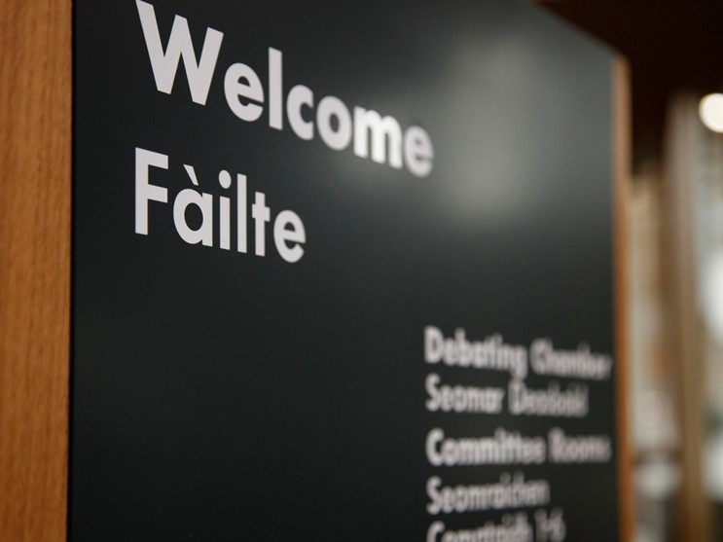
About us (Cont.)
We are committed to providing a great working environment where people enjoy coming to work and feel valued for their contribution and excel in their chosen careers. Everyone has the right to be treated with respect and dignity and we have a zero tolerance approach to bullying, harassment or victimisation of any kind. We recognise that improving employee engagement has a positive and significant effect on organisational performance. We know that ideas generated by colleagues can help shape the future direction of our services and contribute to the successful
delivery of our goals, and our inclusive leadership style guides us in this approach.
We are committed to building a workforce which reflects the diversity of the people of Scotland. We are proud to be an equal opportunities employer that values and respects the people who work for us. We seek to ensure all job applications are treated
fairly, with respect and without bias. We positively encourage applications from suitably experienced candidates regardless of sex, race, disability, age, sexual orientation, gender reassignment, religion or belief, marital status, or pregnancy and maternity. We particularly welcome applications from female and minority ethnic candidates who are under-represented at this level. All appointments will be made on merit.
We are committed to agile working and currently operate a wide variety of work patterns and arrangements across the parliamentary service. We will be pleased to consider
applications from candidates wishing to work flexibly and all requests will be seriously considered. Please include clearly any information about your preferred working arrangements in your application.

